Slide 1
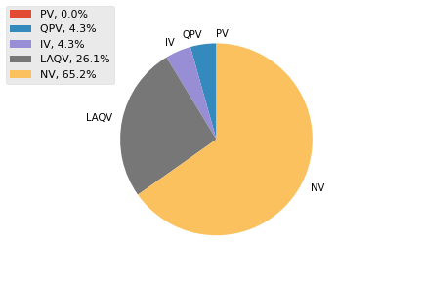
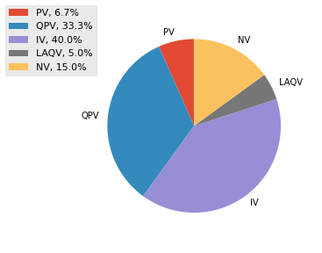
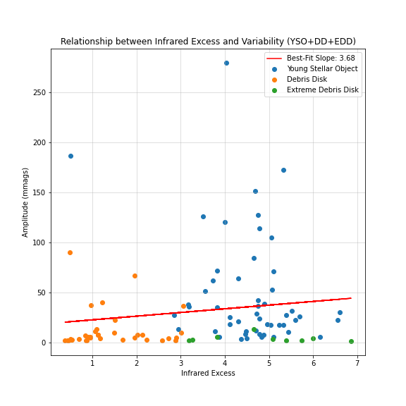
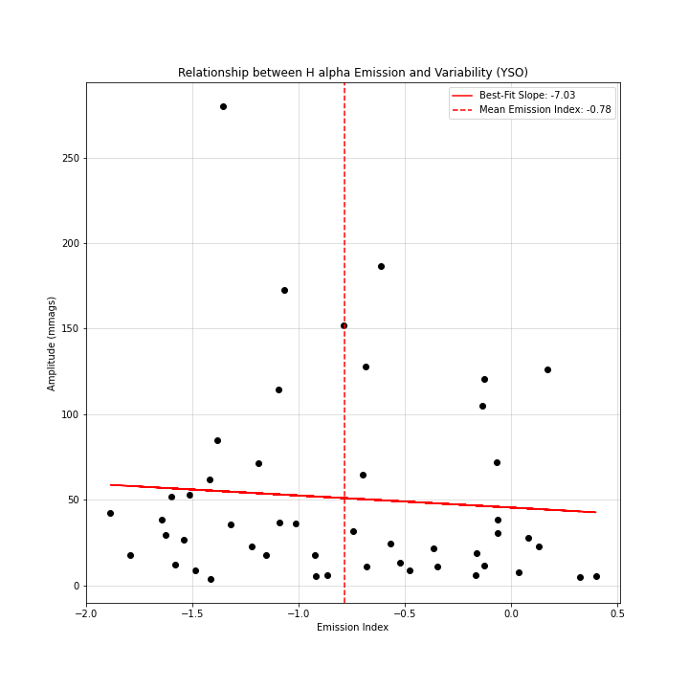
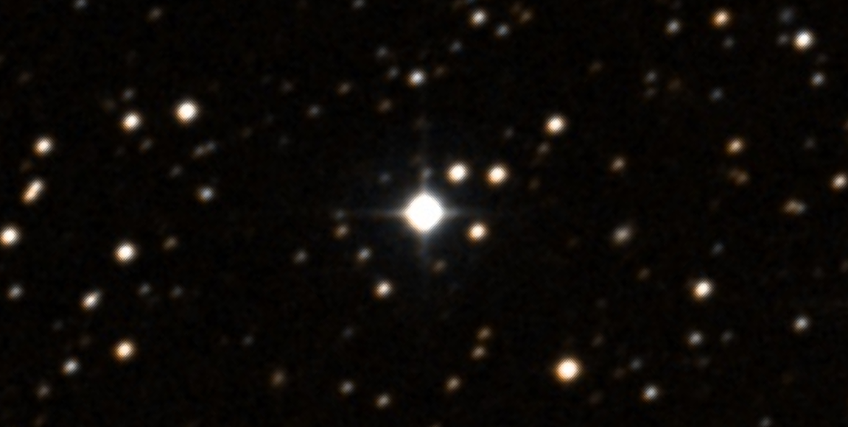
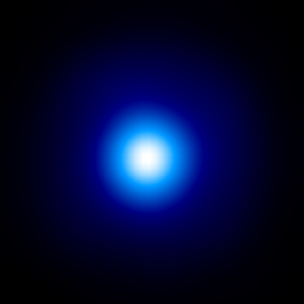
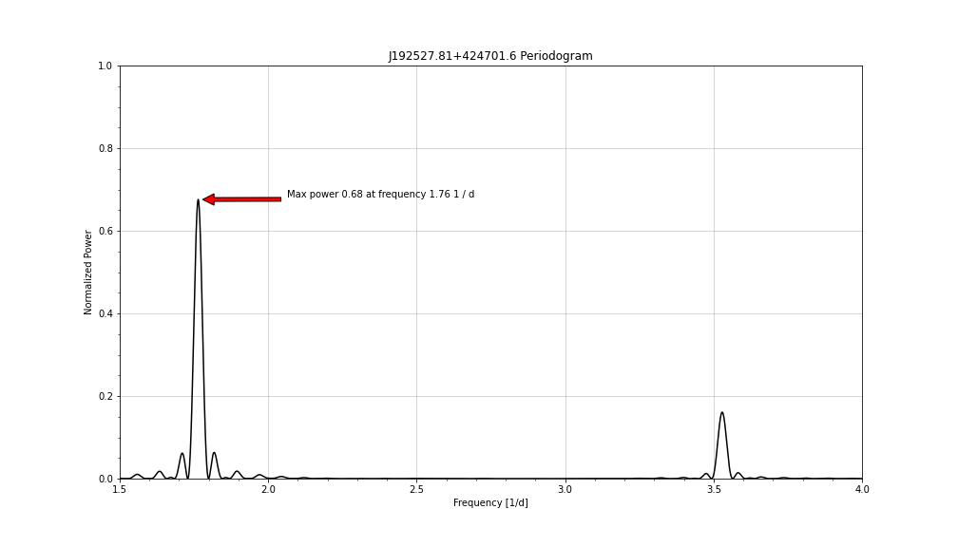
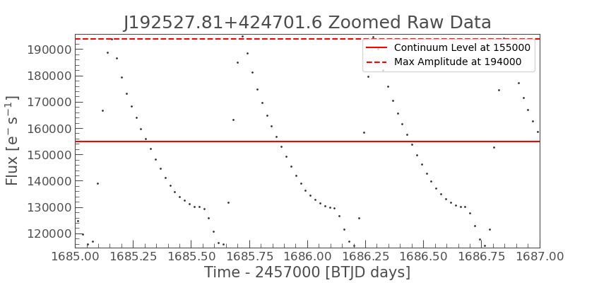
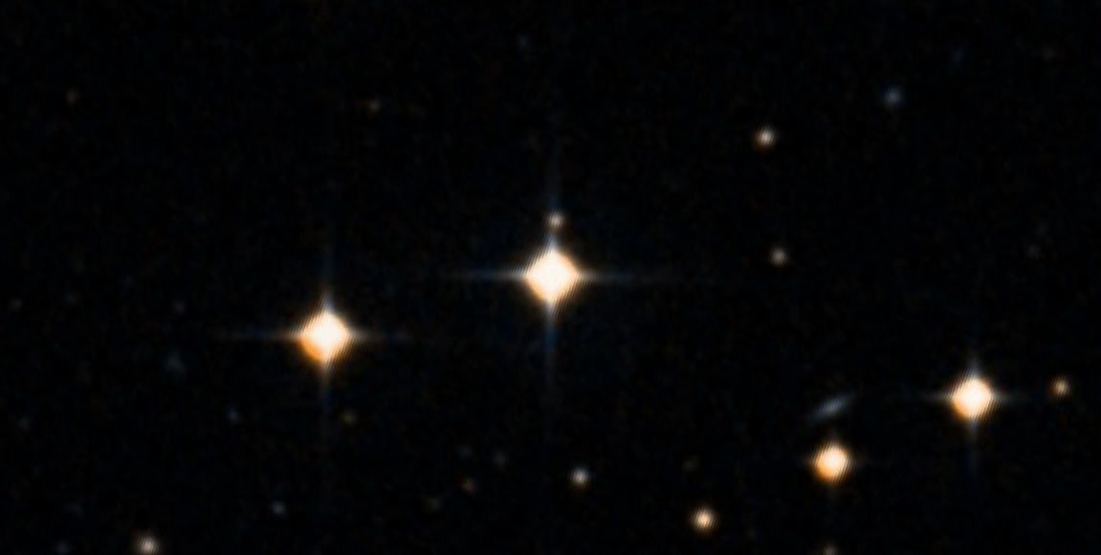
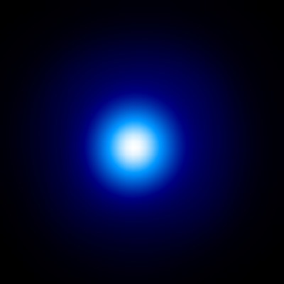
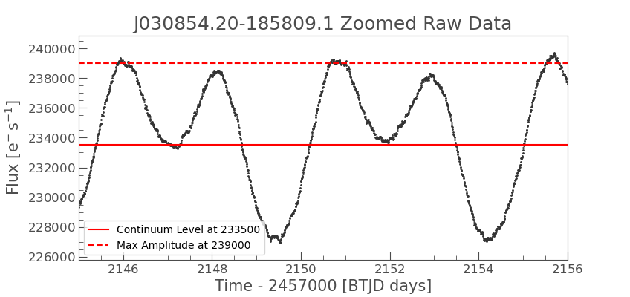
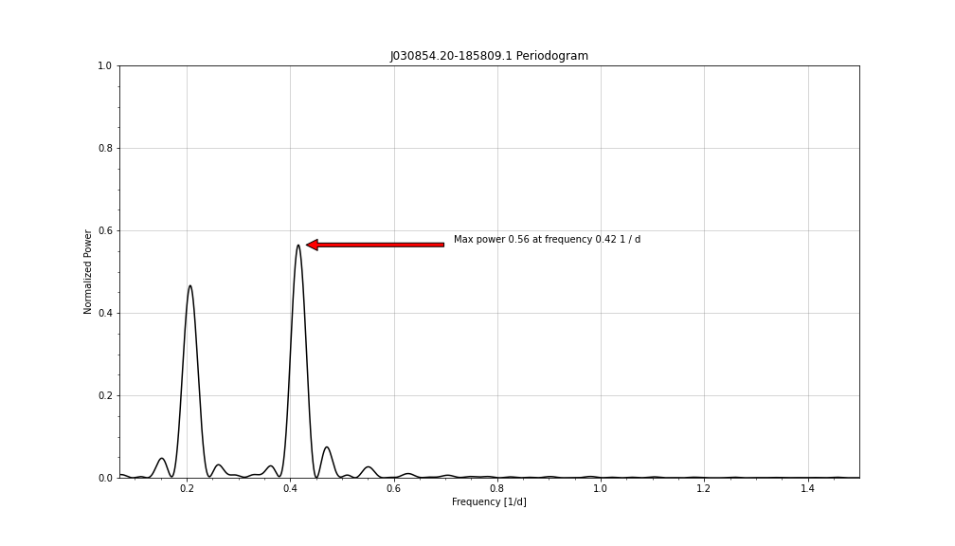
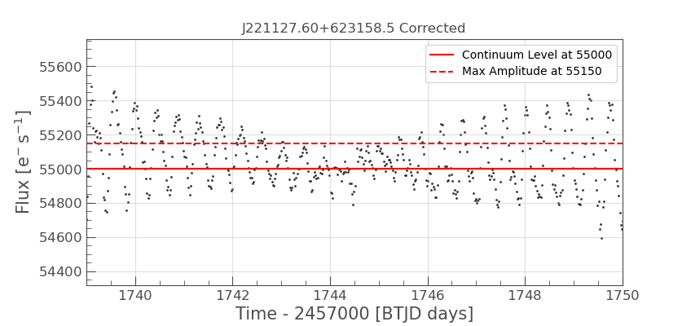
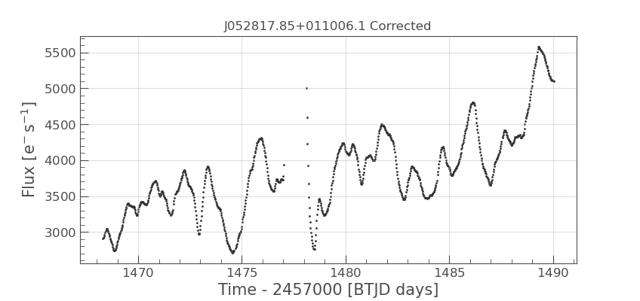
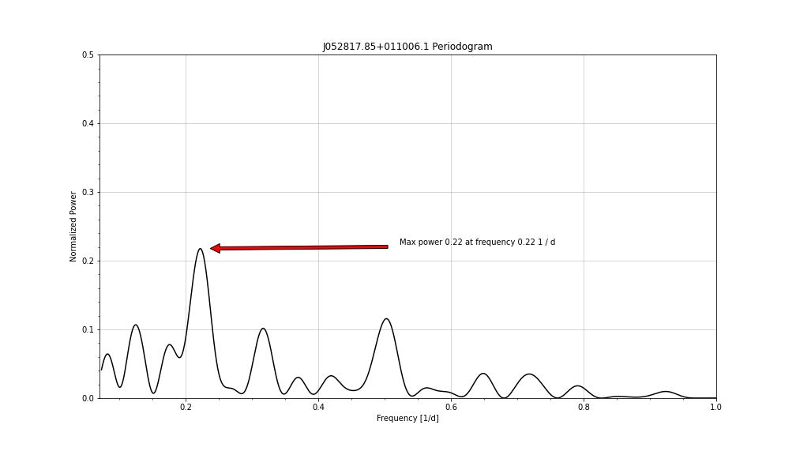
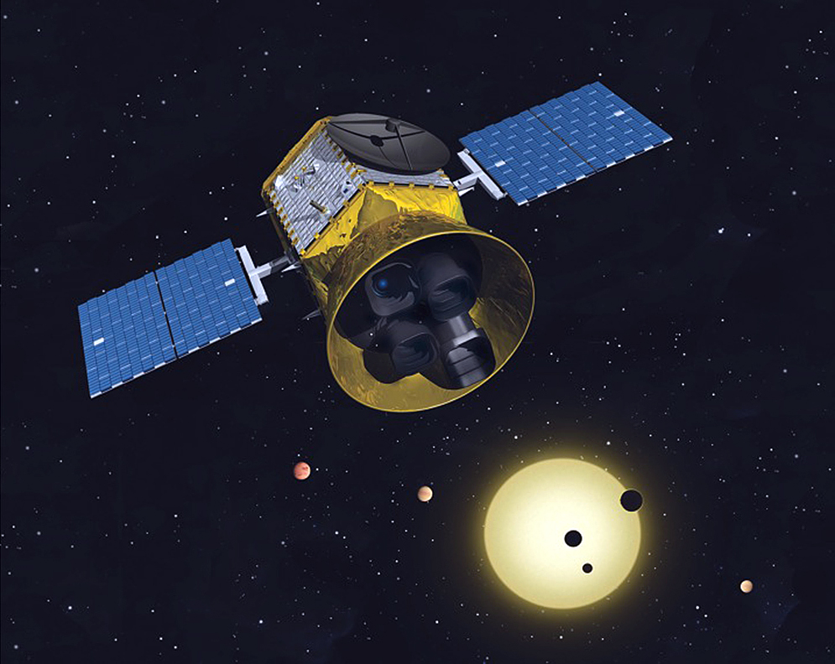
Investigating the Variability of Extreme Debris Disks from Disk Detective
Mingxuan Liu and Alissa Bans
Physics Department, Emory University
Introduction
Assessment Matrix and Validity
Results and Discussions
The NASA-launched citizen science project Disk Detective has uncovered different types of stars with circumstellar dust, including Young Stellar Objects (YSO), Classical Be/Shell stars (CBe), Debris Disks (DD), and Extreme Debris Disks (EDD). EDDs are especially interesting since they have exceptionally large amount of dust compared with DDs. However, EDDs can have similar infrared excess to other types of objects (namely the YSOs), which makes them hard to differentiate especially in the absence of spectroscopic data. Therefore, we want to investigate whether the photometric variability of EDDs can be used to differentiate them from other objects and even understand the major events in the formation stage of solar systems.
Variable Type | Amplitude | Peak Power | Half Peak Width
Periodic Variable (PV) | A > 5 mmags | 0.5 < p < 1 | 0.000 < h < 0.035
Quasi-Periodic Variable (QPV) | A > 5 mmags | 0.5 < p < 1 | 0.035 ≤ h ≤ 0.100
Irregular Variable (IV) | A > 5 mmags | 0 < p < 0.5 | 0.000 ≤ h ≤ 0.100
Low-Amplitude Quasi-Periodic Variable (LAQV) | 2 < A ≤ 5 mmags (PV& QPV) | 0 < p < 1 | 0.000 < d < 0.100
Low-Amplitude Irregular Variable (LAIV) | 2 < A ≤ 5 mmags (IV) | 0 < p < 1 | 0.000 < d < 0.100
Non-Variable (NV) | 0 ≤ A ≤ 2 mmags | NA | NA
Future Works:
Continue to compare the variability of EDDs and YSOs and study whether there exists a differentiator we can use for classification.
Conduct more detail analyses to check the correlation between variability and properties such as Infrared Excess and Hα Emission.
Investigate physical mechanisms behind peculiar objects with public databases and follow-up observation with Emory Telescope.
Figure 5: Variability distribution for EDD(left) and YSO(right). In total, we examined 24 EDDs and 61 YSOs. We found that EDDs have lower occurrence of variability than YSOs, which are composed predominately of QPV and IV.
Table 1: A matrix designed to classify targets according to their variability amplitude and features on the normalized periodogram. Peak power represents the max power, and half peak width represents the width of the highest peak at half power.
Figure 1: Optical and W4 band images for the EDD
J181258.19+272801.3 (top). Optical and W4 band images for the YSO
J011743.47-523330.8 (bottom). They have similar infrared excess and spectral types.
Figure 6: In addition to TESS light curves, clues to the origin of variability may result from checking for correlations in optical variability and other known properties. We observed that stars tend to be more variable if the infrared excess or H alpha emission increases, but the correlation is not very strong.
Data and Data Reduction
Query photometric data collected by the Transiting Exoplanet Survey Satellite (TESS) with the target’s WISE ID
Use Python packages Lightkurve and Astropy to clean and analyze the lightcurve data [1]
Select target masks and remove scattered light in the background to obtain accurate light curves
Create Lomb-Scargle Periodograms and calculate max power and half peak width to classify the targets into PV, QPV, LAQV, LAIV, or NV based on the assessment matrix
Figure 7: The corrected lightcurve of a CBe star J221127.60+623158.5. This target has peculiar variability that may be caused by a two-star system. It is highly periodic in time, but there is clear amplitude modulation in multiple sectors.
Figure 3: The assessment matrix was tested by well-known variables and Disk Detective candidates with literature-examined variability. Top two images show a famous variable star RR Lyrae. The matrix classifies it as PV due to its two differentiable modes. However, the matrix fails for the bottom target, one of our CBe candidates that was identified as PV in the literature. While clearly periodic, the unique signature of two similar peaks per period causes the Lomb-Scargle power to be split into two different frequency signals.
Figure 2: Conceptual image of the TESS mission, launched by SpaceX in 2018. TESS monitors more than 200,000 stars for variability in brightness. It has a 13.7-day orbit period that may induce scattered light from the Earth and Moon. [2]
References
Figure 4: A well-behaved YSO with irregular variability. The assessment matrix successfully classifies it as as IV since its max power is below 0.5.
[1] Lightkurve Collaboration, Cardoso, J. V. d. M., Hedges, C., et al. 2018, Lightkurve: Kepler and TESS time series analysis in Python, Astrophysics Source Code Library, ascl:1812.013
[2] Guerrero, N. (2021, December 21). TESS - Transiting Exoplanet Survey Satellite. TESS. https://tess.mit.edu/

